Slide 1

My Team At Work
Know your colleague’s availability at the office and schedule your plan based on that.

Slide 2

My Team At Work

Slide 3

My Team At Work

Slide 4

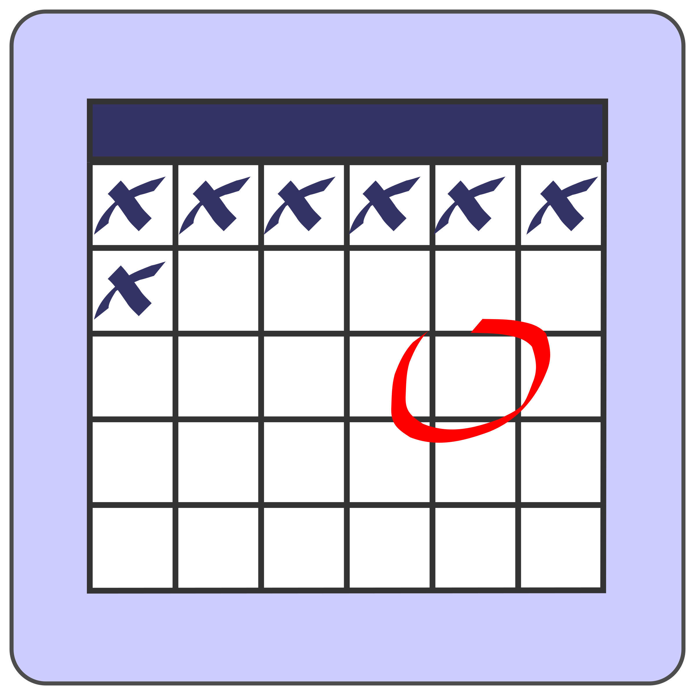


Mail Notification
(Reminder to make your schedule for the month)
Check your folk's availability
Make your own schedule based on other’s availability
Reschedule the dates anytime!
AN ONE PAGE APPLICATION THAT PROVIDES A GREAT CAUSE AND INCREASES PRODUCTIVITY

